Slide 1
Economic crisis and the religions

Slide 2
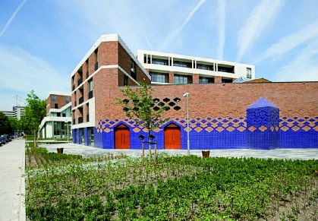
Economic crisis and the religions

Slide 3
Economic crisis and the religions

Slide 4
Economic crisis and the religions
Economic crisis and its consequences:
For the Crisis of the Welfare state
For Migration
For Globalisation

Slide 5
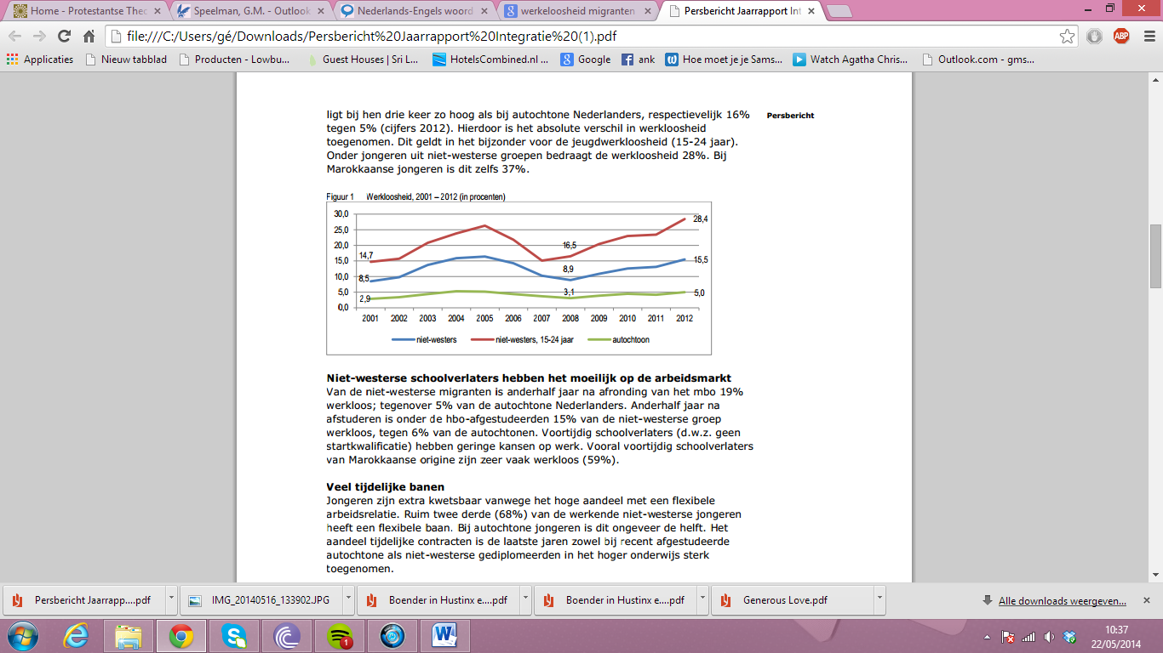
Economic crisis and the religions

Slide 6
Economic crisis and the religions

Slide 7
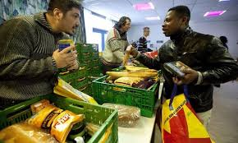
Economic crisis and the religions

Slide 8
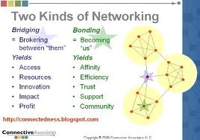
Economic crisis and the religions

Slide 9
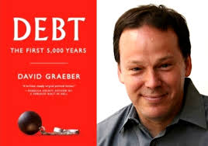
Economic crisis and the religions

Slide 10
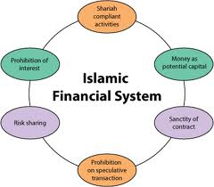
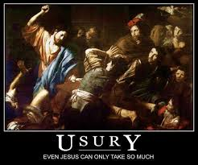
Economic crisis and the religions

